Slide 1
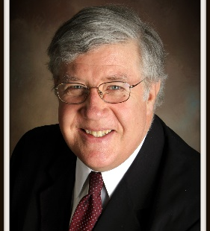

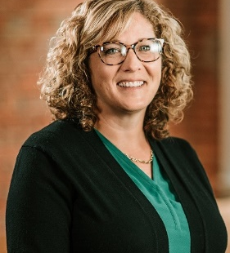
ESOP COMPANY GOVERANCE – WHO DOES WHAT AND INTERACTIVE EXAMPLES OF CHALLENGING ISSUES
Scott Miller
President
Enterprise Opportunities, LLC
Terry Leahy
CEO
MyPath
Dawn Goestenkors
Executive VP
TI Trust, Inc.

Slide 2
ESOP COMPANY “PLAYERS”
Shareholders
*C and S Corporations: Individuals, Entities, ESOT (Trust)
*Focus on 100% ESOP – “Trustee”
Directors
*Inside, Independent Outside (Elected by Shareholders)
Officers
*Appointed by the Directors

Slide 3
C & S Corporation Shareholders
Shareholders (S/H)
C Corporations: Few restrictions on shareholders
* Notable: Individual S/H may be eligible for IRC Section 1042 tax preference transaction
S Corporations:
* Some restrictions
* Often there is a 100% S corporation ESOT
* In 100% ESOT – Trustee votes all the stock

Slide 4
S Corporation – 100% ESOT (ESOP)
S Corporation Shareholders
Tax incentives tilt most S Corporations to 100% ESOT
* 100% ESOT – Trust owns all of the stock
* Few restrictions on who may be the Trustee
* Best practice have Independent Trustee, assumes fiduciary responsibility/liability
* Outside Independent Trustee
* Outside Directed Trustee
* Internal Trustee

Slide 5
S Corporation – 100% ESOT
S Corporation Trustee (assume Independent Trustee)
Major responsibilities
* Votes stock - Appoints/Elects the Board
* Custodian of ESOT Assets
* Determines annual stock valuation
* Ensure ERISA compliance
* Monitor Board of Directors
* Other

Slide 6
S Corporation – 100% ESOT
S Corporation Board of Directors (BoD)
Candidates: Inside and Independent Outside Directors
* Longer term the BoD rules with duties to evaluate Trustee, Directors and Officers
* Issue with 100% ESOT = Control
* Newer ESOTs = Majority of BoD often Independent Outside Directors
* Many BoDs have an odd number to break ties

Slide 7
S Corporation – 100% ESOT
S Corporation Board of Directors (BoD)
Candidates: Inside Directors
* Selling Shareholders often if seller financing
* Officers: CEO, President, CFO
Candidates: Outside Independent Directors
* Former or current ESOP Company Officers
* Former Company Owners selling to an ESOP
* Check available Director candidate directories

Slide 8
S Corporation – 100% ESOT
S Corporation Board of Directors (BoD)
Major Responsibilities
* Duty of Loyalty
* Duty of Care
* Business Judgement Rule
* Typically an important attribute if Director acts in good faith, is reasonably prudent and acts is best interests of Company
* Courts will not typically review BoD decisions if above applies

Slide 9
S Corporation – 100% ESOT
S Corporation Board of Directors (BoD)
Major Duties
* Set corporate strategy
* Appoint Officers, Evaluate CEO/President
* Grow shareholder value
* Monitor Trustee
* Facilitate succession planning
* Other

Slide 10
S Corporation – 100% ESOT
S Corporation Officers
Major Responsibilities
* Manage the Company operations
* Implement strategic plan
* Work closely with the BoD on key issues
* Develop leadership team
* Promulgate employee ownership culture
* Other

Slide 11
Challenging Issues #1
Facts to consider
* 100% ESOP 2016; Seller finance almost amortized
* Seller remains on the Board, serves as Chair
* Seller feels entitled to remain on Board as Founder
* Nothing in documents entitles this thinking
* 3 on Board: Seller, Seller’s brother, one outsider
* Issue: Management and Outside Board member want seller (family) to relinquish control

Slide 12
Challenging Issues #2
Facts to consider
* 100% ESOP since 2010, acquisition debt repaid
* Company is very successful and profitable
* Company receives unsolicited offer to be acquired
* Offer seems to be at or above current FMV of stock
* Issue: Company wants to remain independent and ignore all unsolicited offers

Slide 13
Challenging Issues #3
Facts to consider
* 100% ESOP 2000
* Company receives unsolicited “rollup” offer from BIGCO with 50% premium over recent FMV
* Mature industry, Trustee favors accepting offer
* Independent BoD and Officers reject offer, BIGCO has history of consolidation, closings, staff reductions
* Issue: Conflict between Trustee and BoD/Officers

