Slide 1

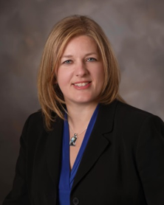

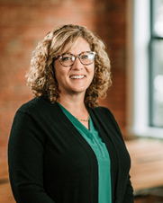



ESOP Transactions
Tabitha Croscut, Esq.
Patrice Radogna, ASA, CPA, ABAR
Dawn Goestenkors

Slide 2
Agenda
ESOP Transaction Timeline
Parties involved in an ESOP Transaction
Trustee Role
Financial Advisor Role
Fairness Opinion Considerations
Attorney’s Role
Financial Advisor’s Deliverables to Trustee

Slide 3
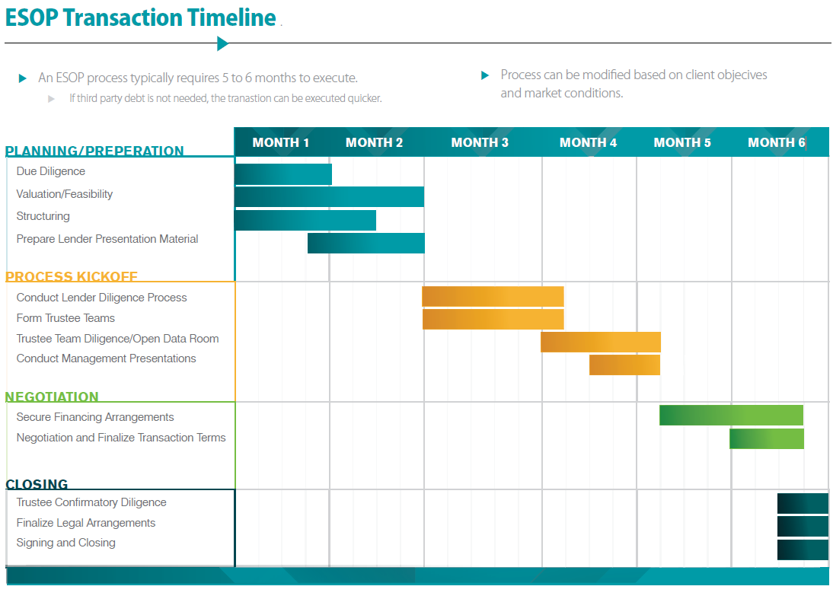

Slide 4
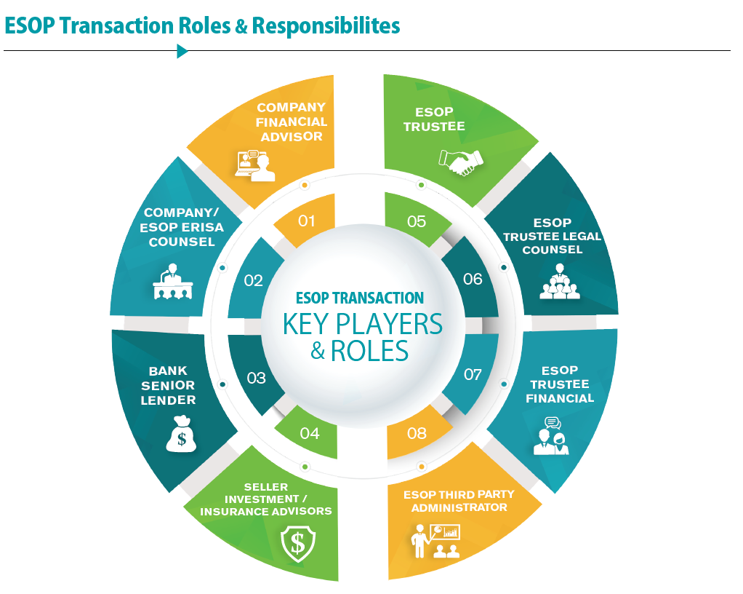

Slide 5
Trustee’s Role in an ESOP
The ESOP trustee holds an essential role as the legal shareholder of the shares held by the ESOP trust.
Fiduciary role that involves numerous, critical responsibilities, which include:
  Duty of loyalty – to act solely in the interest of participants
  Exclusive Purpose rule – for the exclusive purpose of providing benefits
  Duty of prudence – prudent expert standard
  Diversification (ESOP exception – but not from prudence)
  Follow Plan documents (if not contrary to ERISA)
  Avoid conflicts of interest
  Do not engage in “prohibited transactions"

Slide 6
Trustee’s Role in an ESOP
We will take a deeper dive into two key fiduciary responsibilities, in the capacity as an ESOP Trustee:
1. Satisfy ERISA Fiduciary Responsibilities
2. Engage the Independent ESOP Appraiser to help carry out the Trustee’s role of setting the share price for transactions

Slide 7
1. Satisfying ERISA Fiduciary Responsibilities
The Employee Retirement Income Security Act of 1974 (ERISA) sets minimum standards for most voluntarily established retirement and health plans in private industry to provide protection for plan participants. ERISA defines the primary ESOP trustee duties as follows:
An ERISA fiduciary must act solely in the interest of the plan’s participants and beneficiaries while defraying reasonable plan expenses.
  According to ERISA Section 404(a)(1)(B), a fiduciary must act “with the care, skill, prudence, and diligence under the circumstances then prevailing that a prudent man acting in a like capacity and familiar with such matters would use in the conduct of an enterprise of a like character and with like aims.”
  This sets a standard baseline for ethical and prudent behavior — that is, it is neither enough to be either knowledgeable or have the best interests of the ESOP company and shareholders at heart; a trustee must have both qualities.

Slide 8
2.Engage the Independent ESOP Appraiser
Guidance for Trustees in Selection of Valuation Advisor, -per Various DOL Process Agreements
The Trustee should thoroughly vet potential financial advisors to determine if they are qualified and approved to use
    -Some trustees do this with each engagement while others due this as an annual process for all advisors
The Trustee as part of that process collects information from each financial advisor including:
-The firms experience valuing ESOP companies
-Professional affiliations
-Internal controls for issuance of a valuation report and opinions
-Sample valuation report for review
-References
If a trustee approves a list of financial advisors when they are selecting an advisor for a potential engagement
they consider who is the best fit based on items such as:
-Past client experience
-Industry experience
-Location
-Capacity

Slide 9
Financial Advisor Role – Advisor to Trustee
In the capacity of advisor to the Trustee (buy-side), providing key advice on all matters that the Trustee will negotiate with the Selling Shareholder(s)
Key Skillsets:
Valuation, valuation, valuation….
Understanding terms of a deal beyond the valuation (terms applicable in an ESOP or non-ESOP sale)
Communication – written and verbal (all Buy-side and Sell-side members)
Ability to work with Sell-Side Team to navigate and assist the Trustee in negotiating a deal
Ability to be responsive in a fast-paced transaction environment to meet transaction milestones/deadline

Slide 10
Financial Advisor Role – Advisor to Trustee
Develop defensible fair market value range
Post-Transaction Cash Flow Analysis
Analyze and assist Trustee in negotiating all deal terms
Analyze the benefit to ESOP participants (ESOP loan terms)
Provide 2 key deliverables to the Trustee regarding value and the terms of the deal (to be discussed later)

Slide 11
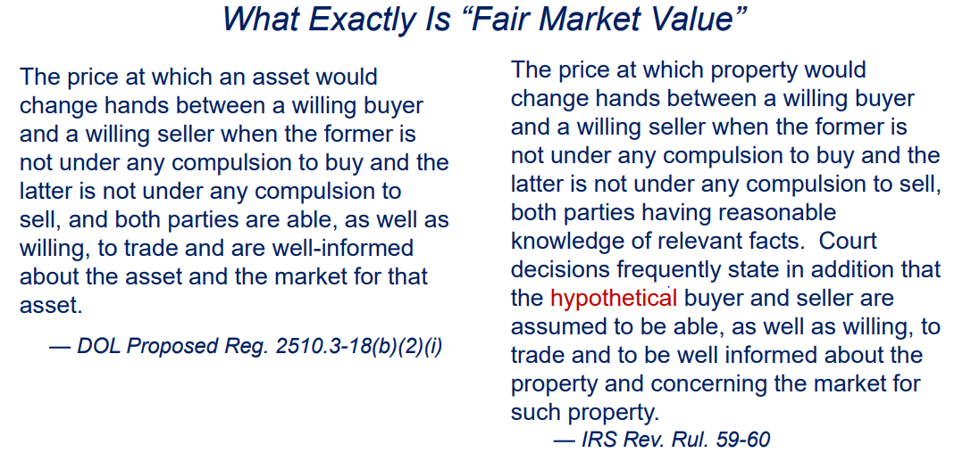
1. Develop Defensible Fair Market Value Range
Role of Financial Advisor to Trustee is to advise the Trustee on the fair market value range, so Trustee can comply with one of their most important mandates: To Not Pay More Than Adequate Consideration………
DOL Proposed Regulations, defining Adequate Consideration, as well as IRS’s definition of Fair Market Value (RR 59-60) are shown below:

Slide 12
2. Post Transaction Cash Flow Analysis
Many Selling Shareholders/Companies WANT to sell to an ESOP Retirement Plan (become a ESOP owned company) – But SHOULD they? Is it sustainable?
Be prepared to show Trustee the post-transaction cash flow analysis considering the deal financing terms to deem that entering into an ESOP Transaction is prudent for the ESOP Participants. ESOP is different from 3rd party side b/c ESOP relies on company to pay-off seller debt or bank debt
Answering the question: Can the Company afford a leveraged buy-out transaction (in this example, assuming leverage is necessary to purchase the shares from the selling shareholders) or does the financing need to be designed differently (e.g. longer term)
Appraiser’s Role: Analysis of this leveraged Buy-out and determining the feasibility of the Company’s capacity to pay down the leverage under the final terms of the deal financing
Analysis to show future cash flow as well as relevant financial/leverage ratios to ensure the company will comfortably be in compliance with applicable bank covenants post-close

Slide 13
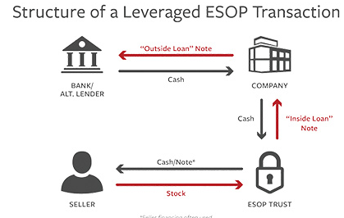
2. Post Transaction Cash Flow Analysis (continued)

Slide 14
3. Analyze and Assist Trustee in Negotiating All Deal Terms
As part of the negotiating strategy, as financial advisor, your role includes:
Provide recommendations to the Trustee on all terms of the deal
Follow process by negotiating terms that are fair to the ESOP
Keep a record of all offers and counter offers to document process
Advise on Target levels of Net Working Capital and Other Financial Measures, as of the Transaction Closing
Work effectively with legal, financial and company teams to ensure accuracy, thoroughness, and that all deal aspects are considered

Slide 15
Advice to Trustee on Purchase Price
Seller typically makes first Offer
Trustee will consider the Purchase Price, in light of range of Fair Market Value
Appraiser’s role to assist Trustee in analysis of Purchase Price in comparison to the range of Fair Market Value
Nuggets to know…
  Arguably the most important term of the deal
  Can often be the one term that delays or negates a transaction
  If the purchase price cannot be agreed on, advisors and trustees will negotiate and provide back-up information to better inform
  Clawback/Earn-out considerations to bridge any gaps in valuation expectations

Slide 16
Financing of Purchase Price- External Note(s)
Cash Financing from Company (no Debt)
Senior Bank Financing
Subordinated Seller Financing
Terms Negotiated for both Senior and Subordinated Notes:
  Amount/Balance
  Interest Rate
  Payment Schedule (Interest only, cash flow sweep, amortizing)
  Prepayment
  Maturity
  Securitization/Collateral
  IRR (for Subordinated Notes with attached warrants)

Slide 17
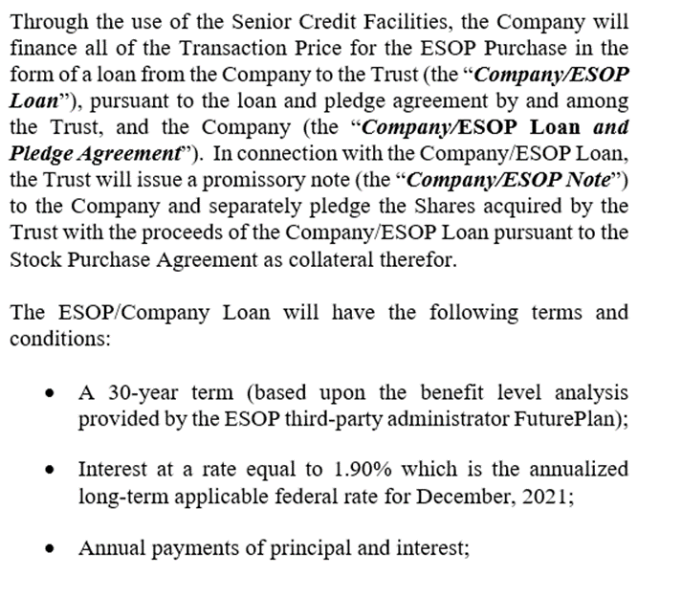
ESOP (Internal) Loan
The ESOP has no money to purchase the shares from Selling Shareholders
The ESOP finances the Purchase Price in the form of a loan from the Company to the Trust
Terms Negotiated:
  Amount/Balance
  Interest Rate
  Payment Schedule (Interest only, cash flow sweep, amortizing)
  Maturity

Slide 18
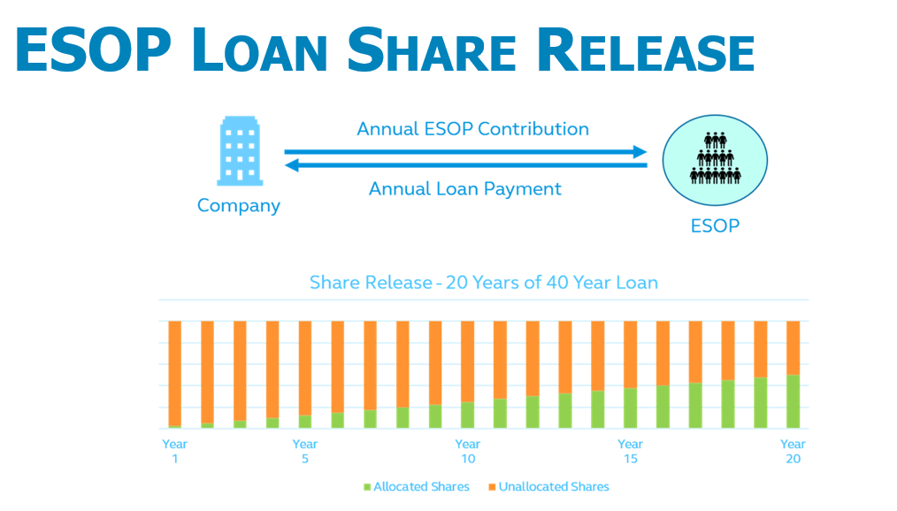
Typical Financing Terms- Term of the ESOP (Internal) Loan drives the Allocation of Shares to ESOP participants - Allocation of Shares drives the Annual ESOP Retirement BENEFITS to the Participants
The shares must be allocated to Participants accounts based on the formulaic repayment of the loan- but there's no tie to the value of the shares released

Slide 19
Advice to Trustee on Other Financial Considerations
Determine if all of below terms are market-based terms:
Terms of Senior Loan and Subordinated Loans (Seller Notes) vs. Terms of Alternative Forms of Financing
Inclusion of Warrants for Seller Notes and applicable market-based IRR
Inclusion of Stock Appreciation Rights (SARs) for key management members
Calculation of total dilution by Warrants and SARs to the ESOP/Buyer
Employment Agreements and expected compensation levels for management/former shareholders
Other forms of deferred compensation levels
Set Target Thresholds for Transaction Deliverables:
Target Working Capital to deliver, as of the Transaction Date
Target Debt on the Company’s balance sheet, as of the Transaction Date
Inclusion of any other assets or liabilities that impact Purchase Price on the term sheet
Set Collars to determine thresholds to make a purchase price adjustment
Appraiser’s Role: To set Target Amounts and, upon a True-Up of actual financial statements as of X Date (typically received 60 days later), re-compute potential Purchase Price Adjustments based on True-Up

Slide 20

ESOP Lawyer’s Role
What can you expect from the ESOP Trustee’s lawyer?
  Confirmation of the terms reflected in the documents
  Participate in the negotiation discussions
  Modifies the documentation based on the negotiation
  Reviews the Due Diligence & Identifies potential liabilities that should be considered in the valuation
  Reviews the Fairness Opinion to confirm the letter is factually accurate
  Assists with communication between the Buyer’s Advisors and the ESOP Trustee’s Advisory Team.
  **Constant and continuous communication among the Trustee Team is critical!

Slide 21
Financial Advisor’s Deliverables to Trustee at Transaction Closing
USPAP-compliant appraisal report opining on range of Fair Market Value (Pre-Transaction)*
Fairness Opinion letter
*With the understanding that the audience is comprised of ASAs (or ASA candidates), we are not going to spend time discussing a fair market value report.

Slide 22
Fairness Opinion Letter to Trustee
The Fair Market Value report will opine on a range of fair market value – to be able to negotiate the Purchase Price Offer
2. The Fairness Opinion Letter typically states (for purposes of an ESOP Transaction):
  The Trustee, in paying the final negotiated Purchase Price, did not pay more than Fair Market value for the Interest in the Company that is being purchased by the ESOP.
  That the terms and conditions of the ESOP Transaction, taken as a whole, are fair to the ESOP from a financial point of view.
    Interest rate on internal ESOP Note is reasonable
    Terms of internal ESOP Note is consistent with what arm's length parties could negotiate
  The Trustee relies on the Fairness Opinion to state that the Trustee was prudent in the process of determining that the ESOP Transaction, taken as a whole, is fair to the ESOP and to the participants of the ESOP, in compliance with the duties of prudence as a Trustee, as required by ERISA (see earlier slide on this).

Slide 23
Fairness Opinion Letter to Trustee
The deal terms covered by the statement: “the terms and conditions of the ESOP Transaction, taken as a whole, are fair to the ESOP from a financial point of view.” typically are:
Adequate consideration
Market terms of all sources of financing
Market terms of ESOP Loan and analysis of expected benefits to ESOP participants
Employment Agreements
Clawback/Earnouts
Dilution to the ESOP (synthetic equity):
- Warrants (attached to Seller Notes)
- Stock Appreciation Rights (SARs) for key members of managements
*Every deal is a custom deal with its own unique deal aspects. The above is illustrative and meant to provide examples of typical deal terms.

Slide 24

Ownership of Company PRIOR to Sale to ESOP
Shareholders
Company
Direct Ownership

Slide 25
ESOP Ownership of Company
ESOP
Participant
Participant
Participant
Participant
Participant
100% Ownership
Company

Slide 26
Thank you!
Please reach out with questions!!
Patrice Radogna, Marcum, LLP – Patrice.Radogna@marcumllp.com
Tabitha Croscut, Devine Millimet & Branch, P.A. - tcroscut@devinemillimet.com
Dawn Goestenkors, TI-TRUST, Inc. - Dawn.Goestenkors@ti-trust.com

Slide 27
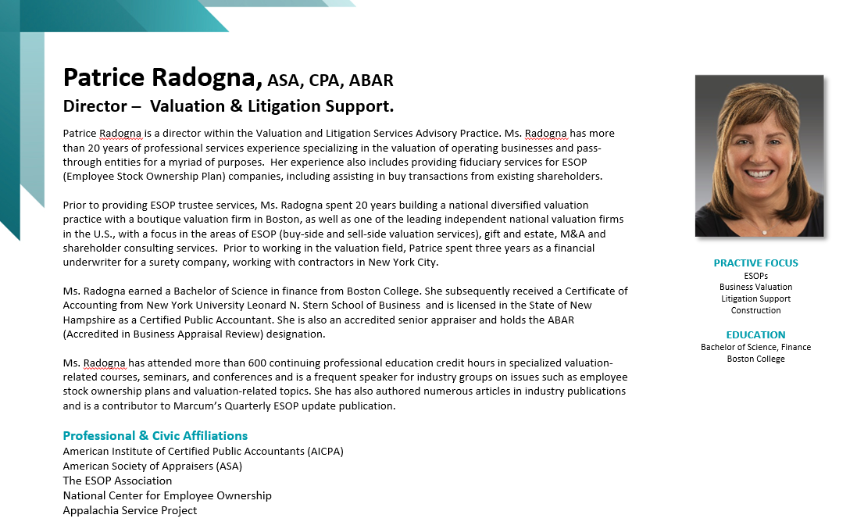

Slide 28
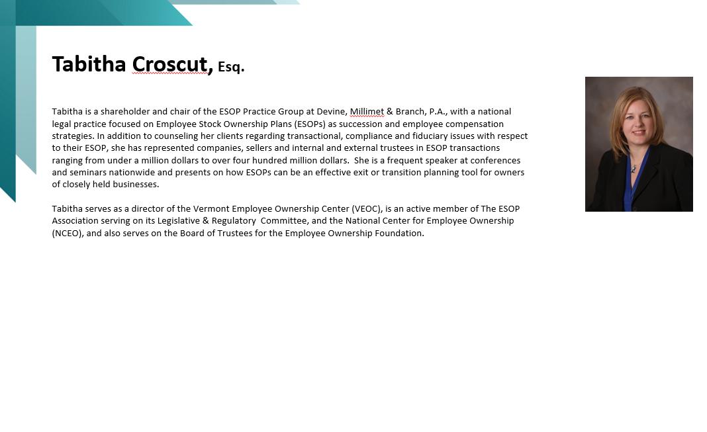

Slide 29


